Slide 1



Online Bookstore Management System
RNS INSTITUTE OF TECHNOLOGY
BENGALURU - 98
DEPARTMENT OF INFORMATION SCIENCE & ENGINEERING
Presentation on Internship
Ritesh Agarwal
USN: 1RN18IS087
TechieAid
Internal Guide
Mrs. Kavya TC
Asst. Prof, Dept of ISE, RNSIT
External Guide
Mr. Ramesh Nediyanath
Designation, TechieAid ,
423, 6th block, 2nd Phase, BSK 3rd Stage, Bangalore, KA 560085

Slide 2
AGENDA
Abstract
About The Company
Introduction
Front end and Back end tools
ER-Diagram
Schema Diagram
Tables description with Normalization
Stored Procedures and Triggers
Results And Snapshots
Applications
Conclusion
References
VIII Semester, Department of ISE, RNSIT
Department of ISE, RNSIT

Slide 3
ABSTRACT
Nowadays, the network plays an import role in people’s life. In the process of the improvement of the people’s living standard, people’s demands of the life’s quality and efficiency is higher, the traditional bookstore’s inconvenience gradually emerge, and the online bookstore has gradually been used in public.
The online bookstore is a revolution of book industry. The traditional bookstores’ operation time, address and space is limited. But the online bookstore broke the management mode of traditional bookstore, as long as you have a computer, you can buy the book anywhere, saving time and effort, shortening the time of book selection link effectively.
The online bookstore system based on the principle of provides convenience and service to people.
VIII Semester, Department of ISE, RNSIT
Department of ISE, RNSIT

Slide 4
ABOUT THE COMPANY
They are IT services company registered under Government of India, Ministry of Micro, Small & Medium Enterprises(MSME).
They offer Software Development Services, Staffing Solutions, Technology Training, Leadership & Soft Skills Training and Coaching & Mentoring.
TechieAid core team comes with 20 plus years of industry experience.
Their mission is to empower the customers with necessary knowledge, skills and resources for them to succeed in their endeavors.
VIII Semester, Department of ISE, RNSIT
Department of ISE, RNSIT

Slide 5
INTRODUCTION
There are many online book stores like Powell’s, Amazon which were designed using Html. I wanted to develop a similar application like that.
The main objective of the project is to create an online book store that allows users to purchase a book based on title, author and category.
Online Book store is an online web application where the customer can purchase books online.
  The user can login using his account details or new customers can set up an account very quickly.
  The books are divided into many categories like best sellers, business and management, fantasy, horror etc.
  Through this application the customers can find the book which he/she desired to buy, later can add to the shopping cart and finally purchase using cash on delivery payment method.
  The Administrator will have additional functionalities when compared to the common user. He can view the registered users, can add, update and delete books which are present in the bookstore and can view the orders which are placed by the customers.
VIII Semester, Department of ISE, RNSIT
Department of ISE, RNSIT

Slide 6
FRONT END TOOLS
Hypertext Markup Language: HTML is a computer language devised to allow website creation. These websites can then be viewed by anyone else connected to the Internet.
Cascading style sheets: It is a style sheet language which is used to describe the look and formatting of a document written in markup language.
JavaScript : JavaScript is a dynamic computer programming language. It is lightweight and most commonly used as a part of web pages, whose implementations allow client-side script to interact with the user and make dynamic pages. It is an interpreted programming language with object-oriented capabilities.
VIII Semester, Department of ISE, RNSIT
Department of ISE, RNSIT

Slide 7
BACKEND TOOLS
Backend scripting language - PHP Hypertext Preprocessor : PHP is used as the server side scripting language. It is a widely-used, open source scripting language. They are executed on the server and since it is a scripting language, it comes with predefined functions which makes it easy to implement any logic necessary.
Web Server – Apache : Apache is an open-source and free web server software, It allows website owners to serve content on the web — hence the name “web server” . Its job is to establish a connection between a server and the browsers of website visitors .
Database – MySQL : MySQL is a fast, easy-to-use RDBMS , it is developed, marketed and supported by MySQL AB . It handles a large subset of the functionality of the most expensive and powerful database packages. . It works on many operating systems and with many languages including PHP, PERL, C, C++, JAVA, etc.
VIII Semester, Department of ISE, RNSIT
Department of ISE, RNSIT

Slide 8
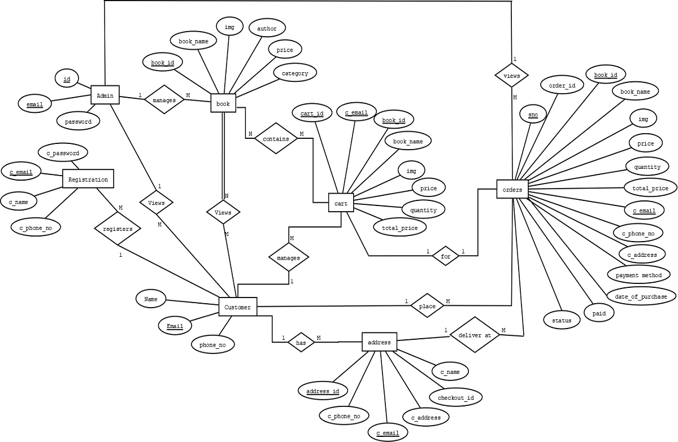
ER-DIAGRAM
VIII Semester, Department of ISE, RNSIT
Department of ISE, RNSIT

Slide 9
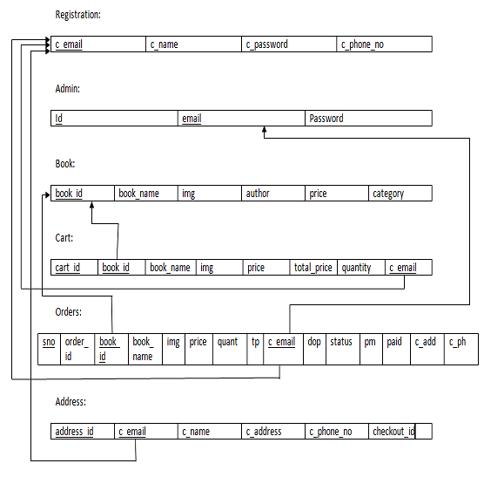
SCHEMA DIAGRAM
VIII Semester, Department of ISE, RNSIT
Department of ISE, RNSIT

Slide 10
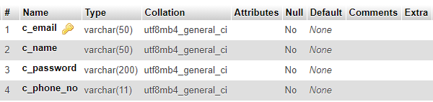
TABLES DESCRIPTION WITH NORMALIZATION
This section describes the tables that are associated with this application. There are total six tables in the database namely registration which contains the information about customer, book which contains the book details, admin table contains the information of the admin, cart contains the books selected by the customer, orders table contains the order placed by the customer and address table contains the delivery information of the customer. The tables are in 3rd normal form.
REGISTRATION:
VIII Semester, Department of ISE, RNSIT
Department of ISE, RNSIT

Slide 11
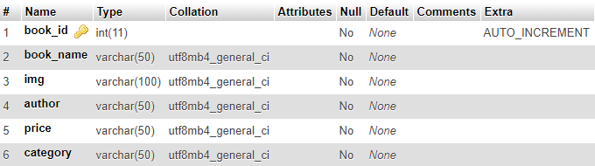
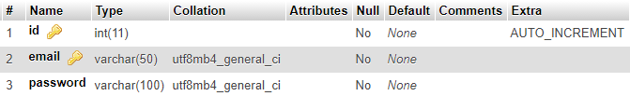
TABLES DESCRIPTION WITH NORMALIZATION
BOOK:
ADMIN:
VIII Semester, Department of ISE, RNSIT
Department of ISE, RNSIT

Slide 12
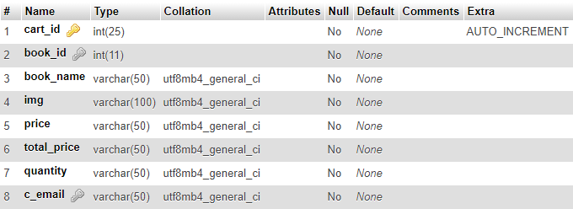
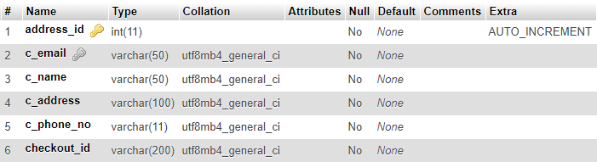
TABLES DESCRIPTION WITH NORMALIZATION
CART:
ADDRESS:
VIII Semester, Department of ISE, RNSIT
Department of ISE, RNSIT

Slide 13
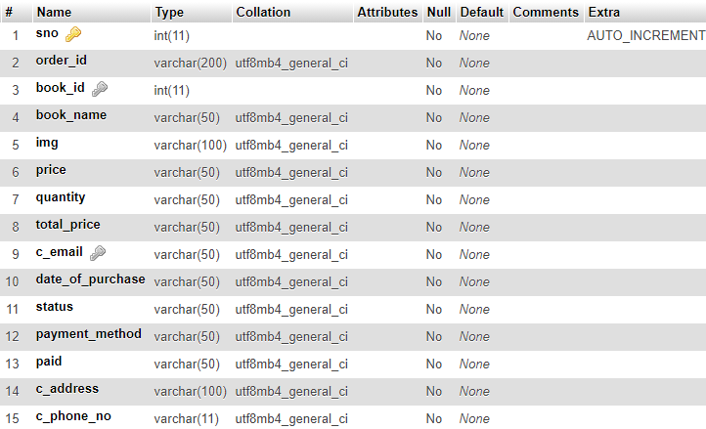
TABLES DESCRIPTION WITH NORMALIZATION
ORDERS:
VIII Semester, Department of ISE, RNSIT
Department of ISE, RNSIT

Slide 14
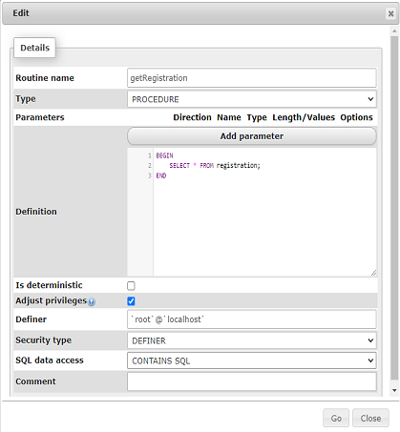
STORED PROCEDURES
One stored procedure is used when the admin wants to view all customers who are registered with the application.
VIII Semester, Department of ISE, RNSIT
Department of ISE, RNSIT

Slide 15
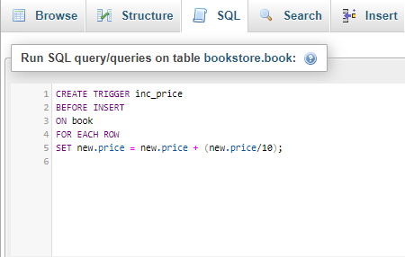
TRIGGER
A trigger is a stored procedure in database which automatically invokes whenever a special event in the database occurs. For example, a trigger can be invoked when a row is inserted into a specified table or when certain table columns are being updated.
In this project a trigger is added to impose a 10 % charge on price of each book.
VIII Semester, Department of ISE, RNSIT
Department of ISE, RNSIT

Slide 16
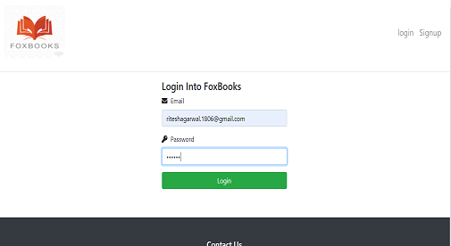
RESULT AND SNAPSHOTS
The above figure is the snapshot of the homepage with the login prompt. If the customer has already registered with the application, he can login using his email ID which he used to register along with the valid password also which he set during sign up.
VIII Semester, Department of ISE, RNSIT
Department of ISE, RNSIT

Slide 17
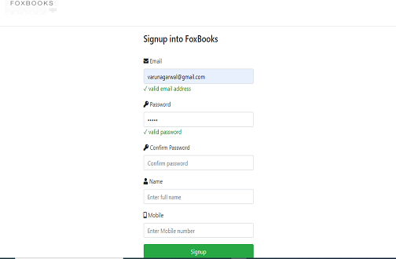
RESULT AND SNAPSHOTS
The above Figure is the snapshot of the signup prompt, if a new user wants to register with the website, he can use this form to register. It accepts the email ID, password, and his contact details like name, phone number.
VIII Semester, Department of ISE, RNSIT
Department of ISE, RNSIT

Slide 18
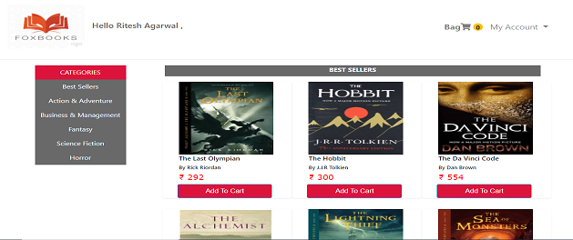
RESULT AND SNAPSHOTS
The above figure shows the index page of the bookstore from where customers can select the books of the desired category he wants to purchase. To add books to the cart the customer has to log in first and if he is already logged in then he can add books by clicking
VIII Semester, Department of ISE, RNSIT
Department of ISE, RNSIT

Slide 19
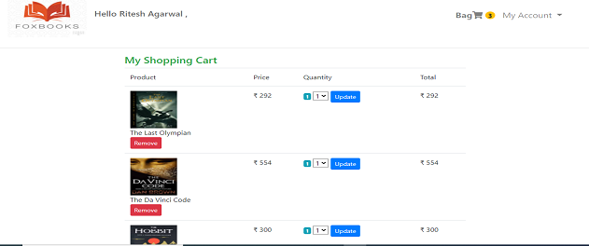
RESULT AND SNAPSHOTS
This page shown in the above Figure displays the list of books which the customer wishes to buy. In the cart he can remove the book if he/she didn’t want it by clicking remove button. The customer can also buy multiple copies of a single book by selecting the number and clicking update.
VIII Semester, Department of ISE, RNSIT
Department of ISE, RNSIT

Slide 20
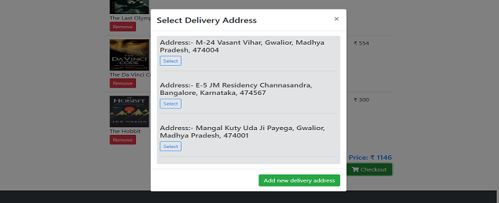
RESULT AND SNAPSHOTS
The above Figure show a modal that prompts the user to select the delivery address on which he wants the order to be delivered. This modal appears when the customer clicks the checkout button on the cart page. This modal also provides the functionality if the customer wants to add a new delivery address.
VIII Semester, Department of ISE, RNSIT
Department of ISE, RNSIT

Slide 21
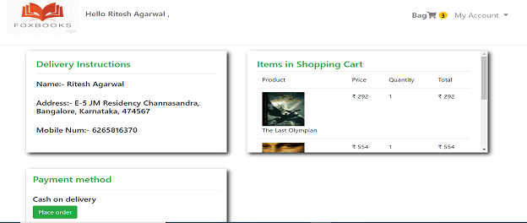
RESULT AND SNAPSHOTS
The above Figure shows the order review page where the customer can review his delivery details and the order before placing the order.
VIII Semester, Department of ISE, RNSIT
Department of ISE, RNSIT

Slide 22
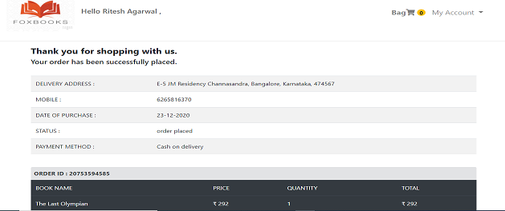
RESULT AND SNAPSHOTS
After clicking the place order button the customer will be directed to the order success page which is shown in the Figure. It shows the date of purchase of the order and status that the order has been successfully placed.
VIII Semester, Department of ISE, RNSIT
Department of ISE, RNSIT

Slide 23
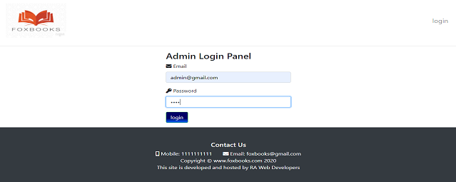
RESULT AND SNAPSHOTS
The above Figure is the snapshot of the admin login prompt. If the admin has registered with the application, he can login using his email ID along with the valid password.
VIII Semester, Department of ISE, RNSIT
Department of ISE, RNSIT

Slide 24
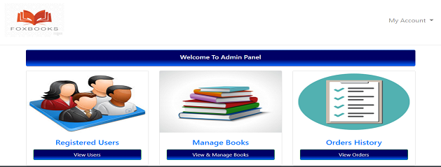
RESULT AND SNAPSHOTS
The above Figure is the snapshot of the admin login panel in which the admin has different functionalities. The admin can view the users who are registered with the application. He/she can view the books that are available in the bookstore along with that he can add new books, delete and update the available books. The admin can also view the orders that are successfully placed by the customers.
VIII Semester, Department of ISE, RNSIT
Department of ISE, RNSIT

Slide 25
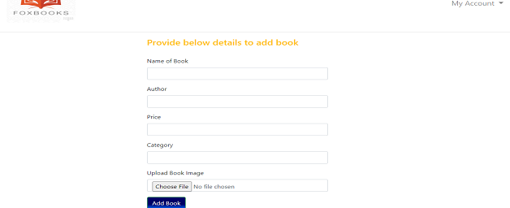
RESULT AND SNAPSHOTS
The above Figure is the add book page in which the admin can add new books in the application by specifying the name of book, author, price, category, image.
VIII Semester, Department of ISE, RNSIT
Department of ISE, RNSIT

Slide 26
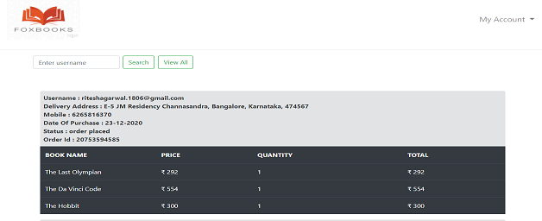
RESULT AND SNAPSHOTS
The above Figure is the snapshot of the order history page where the admin can view the orders placed by a particular user by searching the customer’s email ID. He can also view the orders placed by all the registered customers by clicking on the view all button.
VIII Semester, Department of ISE, RNSIT
Department of ISE, RNSIT

Slide 27
APPLICATIONS
These types of Online Bookstore Management Systems are examples of flourish technology has had on the world. These help customers to purchase books from their laptops, mobiles phones or tablets. They are easy to use and get the job done in very few steps. The old methods of standing and searching for hours is gone.
Major applications of Online Bookstore Management Systems are:
Opting for an online business instead of physical store can save a lot of time and hard work of searching for an ideal store at an ideal location.
Online bookstore is much easier to operate as compared to a physical one.
Online bookstore has larger reach as compared to physical store.
Online bookstore creates more job opportunities than physical store.
Department of ISE, RNSIT

Slide 28
CONCLUSION
This project was an attempt to make the structure and working of an Online Bookstore Management System simpler and user-friendly.
This was an attempt to make it similar to the real world implementation.
In this scenario, all the undertakings of the Online Bookstore Management System were achieved in a constructive manner.
The application is tested to ensure its effectiveness and provide error free functionality to the end user.
Given the right guidance and support its applications and availability can be enhanced.
VIII Semester, Department of ISE, RNSIT
Department of ISE, RNSIT

Slide 29
FUTURE ENHANCEMENTS
Email and notifications could be sent to the customer on successful purchase of books.
Introduction of new payment methods like paying through credit/debit cards, using UPI for transaction.
To create a page where customer can give their feedback.
Providing a functionality where customers can sell their used books.
Hosting this application on an online web server.
VIII Semester, Department of ISE, RNSIT
Department of ISE, RNSIT

Slide 30
REFERENCES
https://www.google.com
https://www.w3schools.com
https://www.stackoverflow.com
https://www.mysql.com/doc
https://docs.microsoft.com
https://www.geeksforgeeks.org
VIII Semester, Department of ISE, RNSIT
Department of ISE, RNSIT

